Slide 1
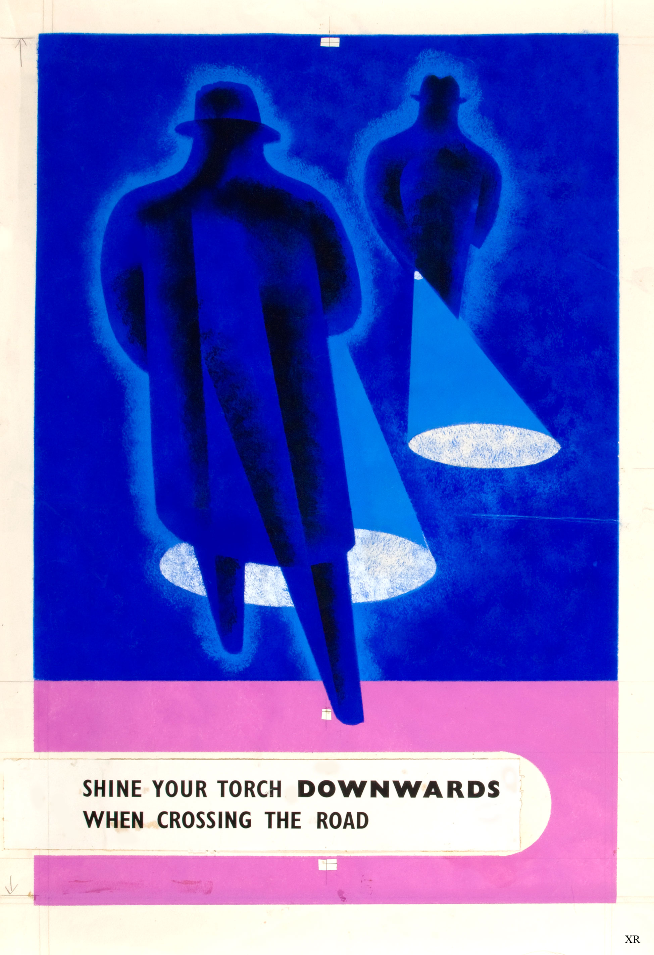

Curriculum overview
Geography/History
European countries – where were the allies and axis?
Longitude and latitude
World War II
Evacuees
Land Girls
R.E
What words can be used to describe God?
What does religion look like around the world?
Art / DT
World War II propaganda posters
Collage of blackout/war scene
Cooking rations
Science
Light – How do you black out light?
Electricity – what would happen if there was no electricity?
PSHE
Family and relationships.
Health and well-being.
Maths
Coordinates of countries
Ratios with rations!”
3D Shapes
Measures
4 operations
Graphs
English
Rose Blanche- diary entry
Creating a spy gadget and writing a non-chronological report.
Multi-genre spy story- children will have spy missions to complete- based on Spy School.
Instruction writing based on a WW2 recipe that they will create.
Portal stories, based on the Lion, The Witch and The Wardrobe
Year 6 -Autumn
Lights out!
Computing
Computing systems and networks: Bletchley Park and the history of computers.
Exploring AI
Music
WW2 songs.

