Slide 1
Parent workshop
Phonics and Reading
Wednesday 9th November 2022

Slide 2
What will be looking at?
What phonics is
Phonics terminology
Segmenting
Blending
‘pure’ sounds
Alternative letters for different sounds
Government expectations
Our chosen phonics programme
What a week of phonics at Larchfield looks like
Other phonics resources
Reading with your child at home
Our online reading programme
Year 1 government phonics screening test

Slide 3
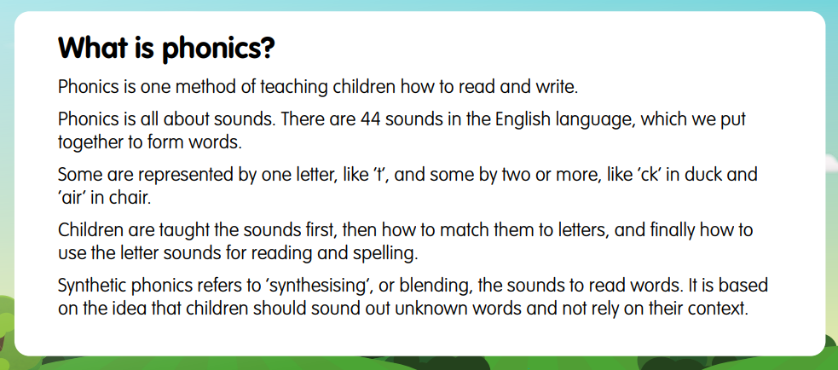

Slide 4
Terminology
Phoneme, e.g. /b/
Graphemes, e.g. ‘b’
Digraph, e.g. /ai/
Trigraph, e.g. /air/
Split digraph, e.g. /a_e/
Blend, e.g. /sp/, /ng/

Slide 5
Segmenting
Breaking down words for spelling.
cat
c a t

Slide 6
Blending
Building words from phonemes to read.
c a t
cat

Slide 7
Pure sounds
/s/ + /uh/ = /suh/
https://www.youtube.com/watch?v=UCI2mu7URBc

Slide 8
Why learning to read and spell in English is so hard!
/a/ a a-e ai ay ey eigh
/e/ e e-e ea ee y
/i/ I i-e ie igh y
/o/ o o-e oa oe ow
/u/ u u-e ue oo ew
/ow/ ow ou ough
/oi/ oi oy
/ar/ ar a
/or/ or aw ore a ough
/air/ are ear
/eer/ eer ear

Slide 9
Government Guidance on the teaching of phonics 2022
The government has reviewed its guidance on the teaching of phonics and set criteria which phonics schemes have to adhere to.
By ensuring high-quality phonics teaching the government wants to improve literacy levels to:
give all children a solid base upon which to build as they progress through school
help children to develop the habit of reading widely and often, for both pleasure and information

Slide 10
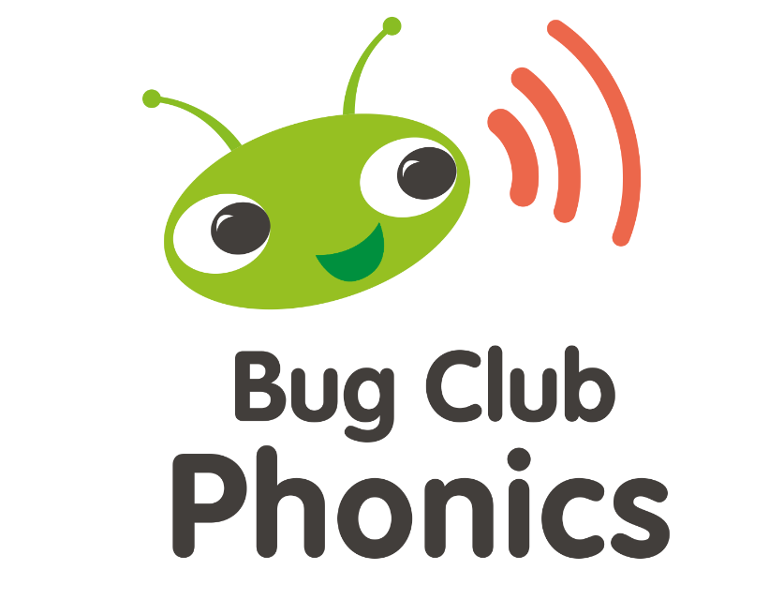
Why?
Meets government criteria
We already have ‘Bug Club’
The children know the ‘bug’
Online and interactive
Covers everything it should
https://youtu.be/0dCRWLLNXPo

Slide 11
What will a phonics session include?
All children will have 4 sessions of phonics as a whole class each week with additional phonics groups taking place for those needing further support
On Fridays instead of a phonics session using Bug Club, all children do guided reading using Bug Club Phonics books
What does a phonics session look like in?
Reception
Year 1
Year 2

Slide 12
Phonics resources
Mr Thorne does phonics - https://www.youtube.com/channel/UC7sW4j8p7k9D_qRRMUsGqyw
https://www.youtube.com/watch?v=uwTkcfKRj00&list=PL7reyKMEPH-SlBkVaPKIlPI1xtbTNVjEk&index=18
Alphablocks –https://www.bbc.co.uk/cbeebies/shows/alphablocks
Phonics play -https://www.phonicsplay.co.uk/
Topmarks - https://www.topmarks.co.uk/Interactive.aspx?cat=40

Slide 13
Supporting your child’s reading at home
Reading Books
All children in Reception, Year 1 and Year 2 will receive two reading books a week (as well as a library book). These two books are to be read at home and need to be returned to school to be changed on a Monday and Thursday.
Year 1 and Year 2 - When reading with your child, we suggest this pattern.
1st read - Look at the pictures and help your child to explain the story
2nd read - Ask your child to read the book concentrating on the phonics
3rd read – Focus on using a storyteller voice and developing fluency for the words read.
4th read– Ask your child questions about the story to develop their comprehension.
If your child has a book with no words, focus on telling the story from the pictures. Please see reading guidance sent home to Reception parents in September.

Slide 14

Bug Club
An online Reading programme
School allocate reading books to each child in the class
Books are ‘levelled’ so that they are not too hard and not too easy
Each book has ‘bug’ icons throughout it – children click on these to answer questions about what they have read

Slide 15




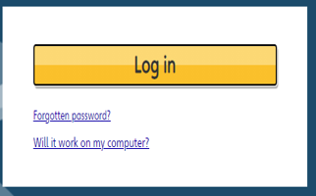
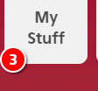
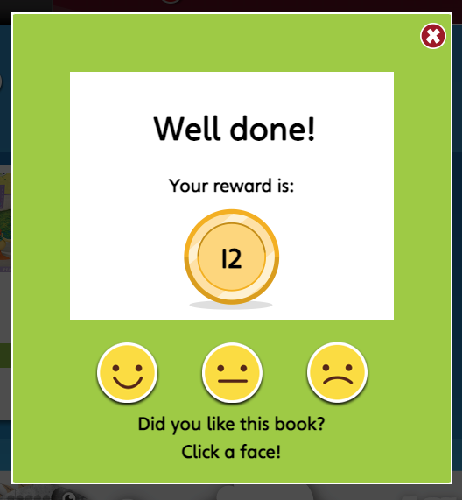
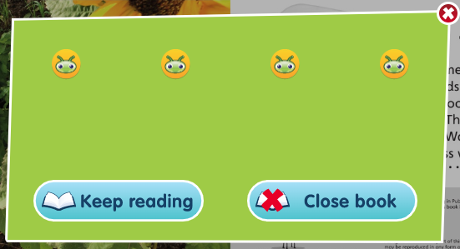
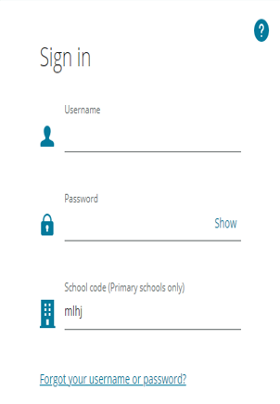
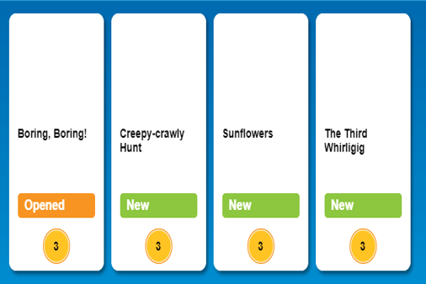
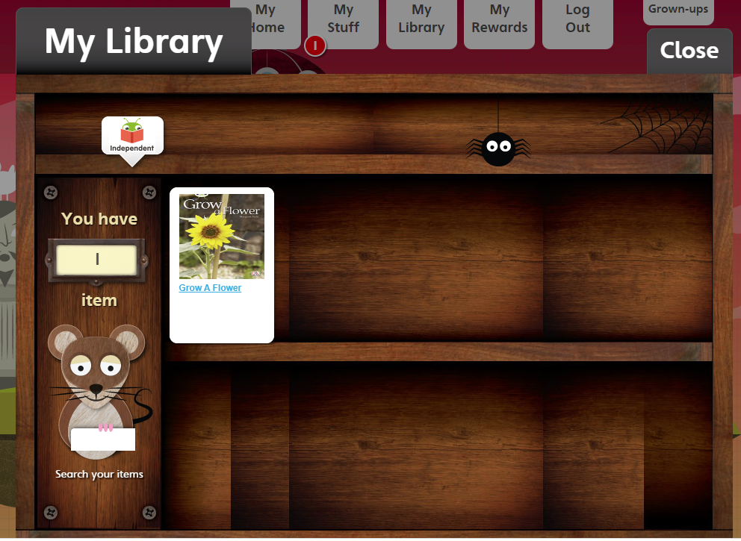


How to use Bug Club at home with your child
https://www.activelearnprimary.co.uk/login?c=0

Slide 16
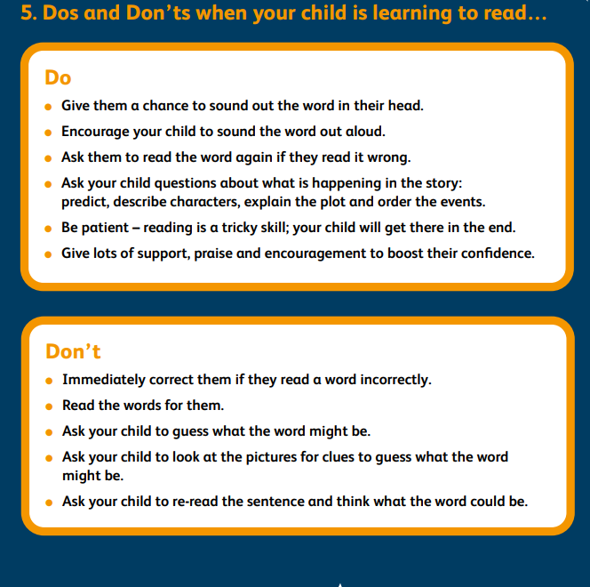
The most important thing is that you and your child have fun while they are reading or you are reading to them.
Here are some other suggestions.
Another top tip is to consider reading with your child in the morning as sometimes they are more willing to read!

Slide 17
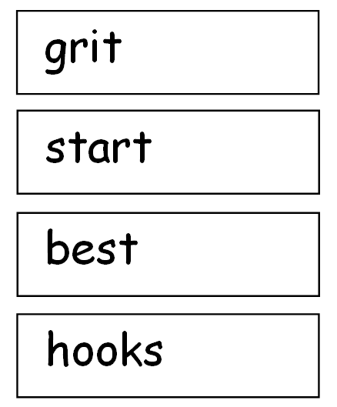
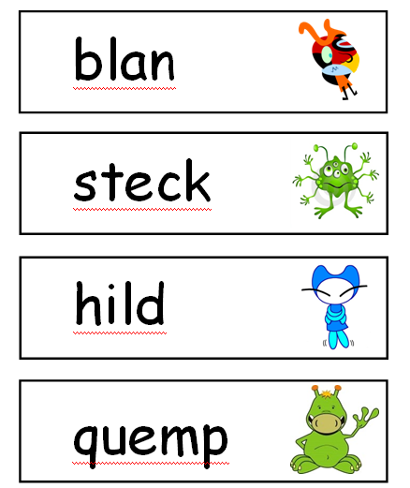
Year 1 Phonics Screening – June
The aim of the Phonics Screening check is to give teachers and parents information on how children are progressing in their reading; to see if children can read different words using the phonics knowledge that they've been learning
Total words – 40
Real and Non-words

