Slide 1

Welcome
Year 6 Parents’ Information Meeting

Slide 2
What a Fantastic Start!
Enthusiastic
Responsible
Eager
Willing
Smart

Slide 3
Long may it continue…
Stay focussed in lessons
Setting a good example to the rest of the children in all areas of the school
Appreciate how their behaviour, in and out of the classroom, can affect others
Come to school, fully equipped and ready to learn

Slide 4

What are the SATs?
Standard Assessment Tests produced by the ‘Qualifications and Curriculum Development Agency’ They are designed to test children’s attainment at the end of Key Stage 2. They are marked externally.

Slide 5
Why are SATs important?
They are used to measure your child’s progress since Key Stage 1 tests (Age 7).
The results are communicated along with their teacher assessments to their secondary schools.
The levels are reported to the DfE, provide a basis for ‘League Tables’ and are inspected by OFSTED.

Slide 6
What tests do the children take?
Monday May 10th 2027: Spelling, punctuation and grammar – Paper 1 (Grammar/Punctuation Test) – 45 minutes
Monday May 10th 2027: Spelling, punctuation and grammar - Paper 2 (Spelling Test) – 20 minutes
Tuesday May 11th 2027: Reading Test – 60 minutes
Wednesday May 12th 2027: Maths Paper 1 (Arithmetic) – 30 minutes
Wednesday May 12th 2027: Maths Paper 2 (Reasoning) – 40 minutes
Thursday May 13th 2027: Maths Paper 3 (Reasoning) – 40 minutes

Slide 7
Reading Test
60 minutes long
Usually contains 3 different, unrelated texts
Total marks – 50
A variety of questions worth 1 – 3 marks each.

Slide 8
Reading Test Questions
Give and explain the meaning of words in a context.
Retrieve and record information.
Summarise ideas from the text.
Make inferences from the texts and justify them with evidence from the text.
Predict what might happen.
Identify and explain how the content in a text is related.
Explain how meanings in a text are enhanced through choice of language.
Make comparisons between texts.

Slide 9
In Summary
Multiple choice, ordering, matching, labelling, recording and find and copy.
Open-ended response questions still require pupils to explain fully, justifying their answers, using the text as support (2/3 mark questions)

Slide 10
How can you help?
Encourage your children to read as often as possible
Make sure that they are reading a wide variety of material that will stretch them.
Chat with your child about the books that they are reading (Why do they like/dislike them? Why do they think that the character behaved as they did? How would they change the plot of this story?)
Make sure that they practice inferring things that are not directly written. (“Mrs Smith came into the room, red faced and clenching her fists”- How is she feeling? How do we know?)

Slide 11
SPaG Test
Paper 1 Spelling
20 minutes 20 marks
Paper 2 Punctuation and Grammar
50 minutes 50 marks
Total marks 70.

Slide 12
Spelling Paper
Tests a variety of spelling rules
Children have to write the missing word in a sentence:
Sam is________ to play football at playtime. (eager)
Use a _________ruler to draw a line. (straight)
Being dizzy is a strange__________ . (sensation)
Lauren was __________before her first swimming lesson. (terrified)

Slide 13
Punctuation and Grammar Paper
Grammatical terms and word classes (nouns, verbs, adjectives prepositions, adverbials).
Functions of sentences (commands, statements, questions).
Combining words, phrases and clauses (conjunctions, noun phrases, different types of clauses).
Verb tenses and consistency (past and present, verb tenses, active and passive).

Slide 14
Punctuation and Grammar Paper
Punctuation (full stops, capital letters, commas, apostrophes brackets, semicolons, hyphens).
Vocabulary (synonyms, antonyms, prefixes and suffixes).
Standard English (formal and informal language and structures)

Slide 15
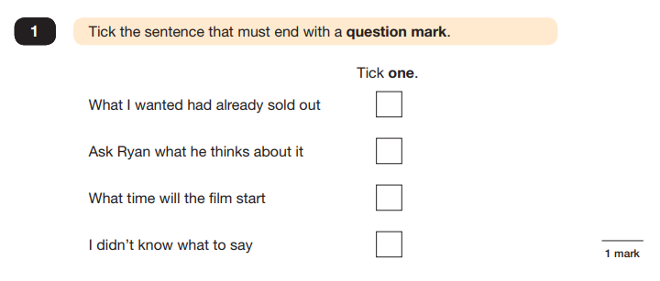
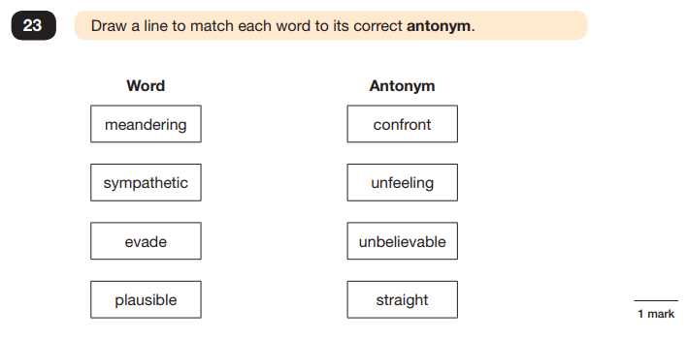
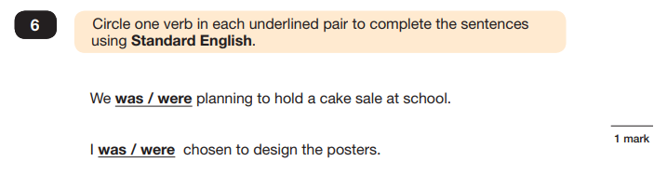
Grammar, Punctuation and Spelling Examples:

Slide 16
How can you help?
Help your child to learn the Y6 spelling list!
Use punctuation to help them make sense of a piece of written text
Make sure that they learn their weekly spellings and know what the words mean
Look at punctuation used in newspapers etc. to help increase their knowledge.
Work with them on SPaG home learning activities

Slide 17
Mathematics Papers
Mental Arithmetic Paper 1 – 30 mins 40 marks
Reasoning Paper 2 – 40 mins 35 marks
Reasoning Paper 3 – 40 mins 35 marks
Total marks 110
NO CALCULATORS!

Slide 18
How can you help?
Help your child to develop rapid recall of times tables facts up to 12 x 12 by heart (as well as their inverse operations) TTRS
Encourage use of Maths in everyday life: Change in shops; timetables of buses and trains; opening hours of businesses; graphs that forecast weather
Use online activities (nearly all free!) to help them with topics that they are unsure of
Support them with their home learning

Slide 19
Writing
No test
Teacher assessed
Moderated in school and within Borough
Children need to produce evidence of independently achieving a number of criteria

Slide 20
What year 6 writing should include:
Write for different purposes and audiences
Use paragraphs to organise ideas
Use devices for cohesion (conjunctions, adverbials, pronouns, synonyms)
Use a range of punctuation mostly correctly:
. ? ! , ’ “”
Spell most Y3–4 and Y5–6 statutory words correctly
Handwriting is legible and joined

Slide 21
How can you help?
Read over any writing that they have done to make sure that it makes sense.
Help them with developing a good-handwriting style (buy a pencil-grip if needed)
Encourage them to write at home (stories; thank you notes; Birthday cards; shopping lists)
Broaden vocabulary by checking the meanings of new words and using a Thesaurus
Ensure your child is eating well and getting a suitable amount of sleep
Limit their time on devices!

Slide 22
Children – How can you help yourself?
Listen to what your teacher says;
Your teacher is cheering you on and wants you to do your best;
Make sure you get plenty of sleep and stay well fed – sleep and food help keep the brain moving;
Read the questions carefully. This can help to avoid any silly mistakes!
Don’t worry if there’s something you can’t answer. Take a deep breath! You can always move on and go back later but it’s better to write something rather than nothing;
Keep in mind year 6 SATs are just one week of your entire life!

Slide 23
Secondary School Transition
Apply between: 1st Sept – 31 Oct 2026
Where to apply: RBWM residents → Online via Synergy Application Portal (new system – all must register)
Non-RBWM residents → Apply through your own local authority
List all available preferences (up to 6) – missing ones will be added for you
Include both grammar & non-selective schools in your 6 preferences
Support: rbwm.admissions@achievingforchildren.org.uk
Deadline: 31 October 2026

Slide 24
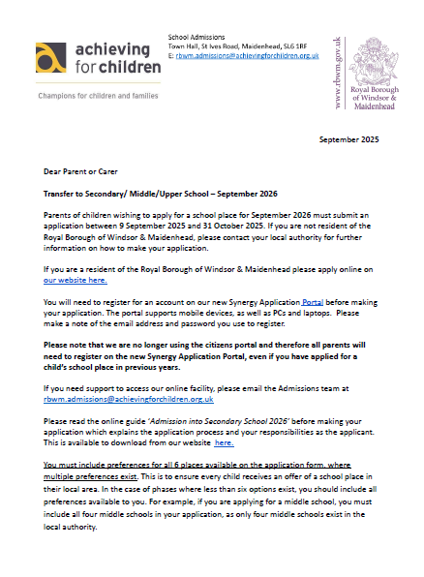
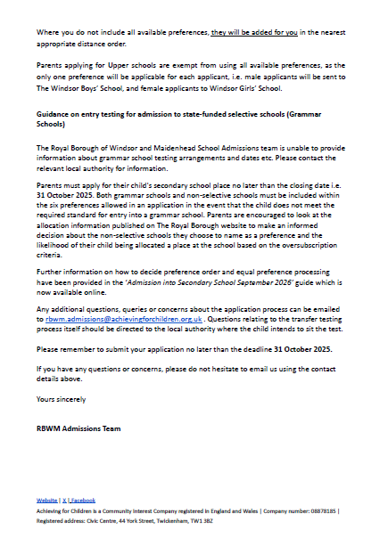

Slide 25
Secondary School Options in Maidenhead
Altwood C of E
Cox Green
Desborough College
Newlands Girls
Furze Platt Senior

Slide 26

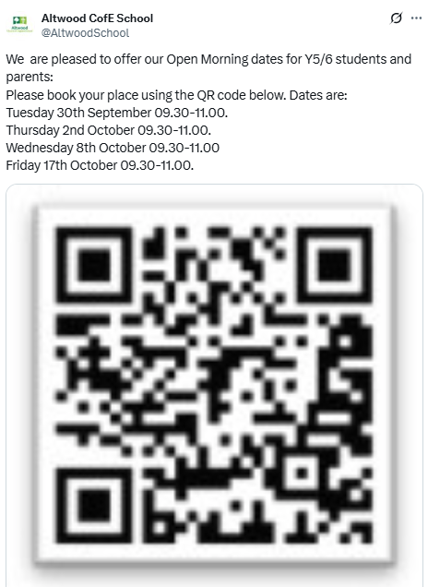


Slide 27
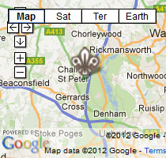
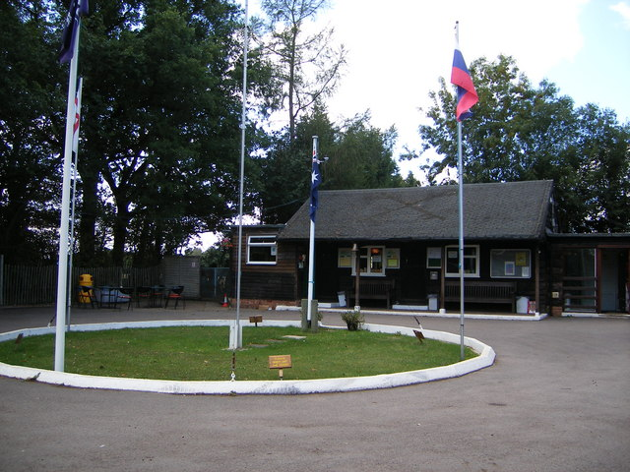
Y6 Residential Trip
Paccar Scout Camp
Monday 19th May – Wednesday 21st May

Slide 28
Aims and Objectives:
Transition to Secondary Education
Personal development
Growing independence
Confidence building
Increased motivation
New experiences
Tailor-made program
Action-packed sessions each day
Evening entertainments

Slide 29
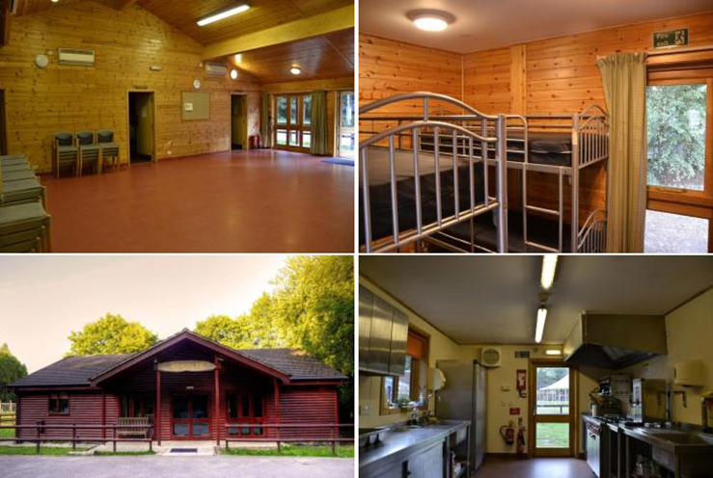
Facilities at the Centre
Purpose built activity centre
Secure dormitory rooms with showers
Fully-catered and can meet all dietary requirements
Professional staff on-site at all times

Slide 30
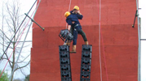
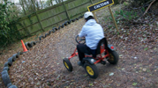
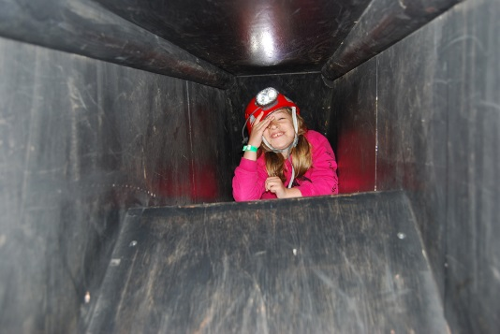
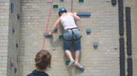


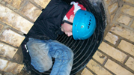
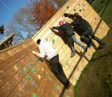
Activities
~ Climbing Wall ~ Crate Stacking ~ Pedal Go Karts ~ Caving
~Camp fire ~ High Ropes ~ Tunnelling ~ Traverse Wall ~ Movie Night

Slide 31
Paccar Residential
Total Cost: £185
Deposit deadline – 1st November 2026
Paccar Residential Payment Scheme
Date | Amount Due
1st November 2026 | £50 (Non refundable deposit)
19th December 2026 | £50
19th February 2027 | £45
22nd March 2027 | £40
 | Total: £185

Slide 32
Any Questions?

