Slide 1


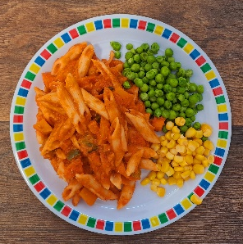
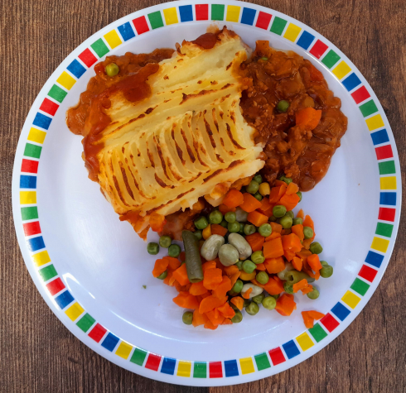
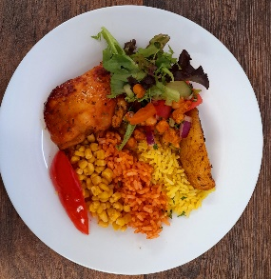
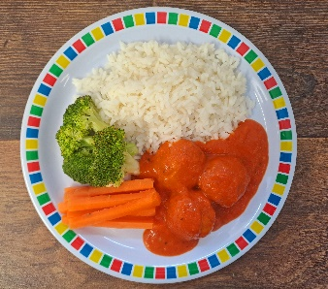

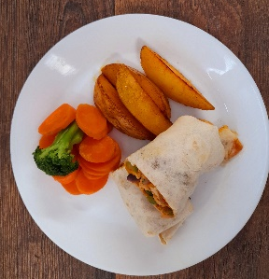
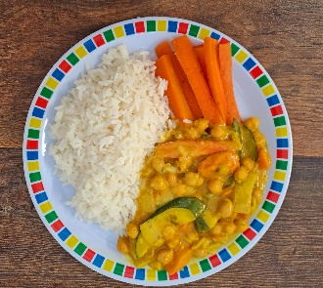
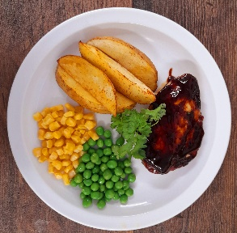
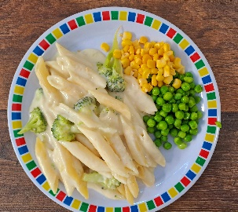
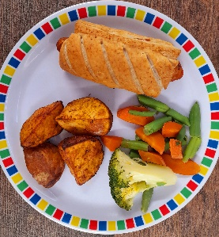
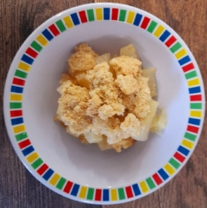
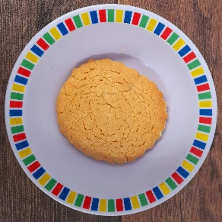
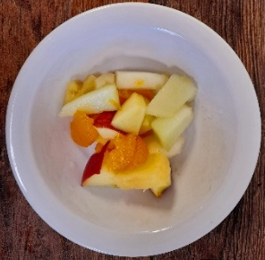
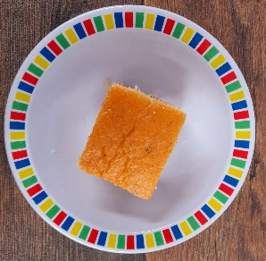
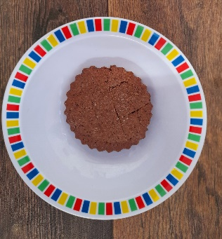
Autumn Winter 2024/2025
Tomato and Vegetable Pasta
Cottage Pie with Gravy
Peri Peri or BBQ Chicken with Seasoned Potatoes
NEW Chicken Meatballs in Tomato Sauce with Rice
Salmon or Pollock Fish Fingers with Chips & Tomato Sauce
Mexican Fajitas with Rice
NEW Creamy Chickpea and Coconut Curry
Peri Peri or BBQ Quorn with Seasoned Potatoes
NEW Cheese and Broccoli Pasta with Garlic Bread
Mexican Bean Roll with Chips and Tomato Sauce
Apple and Blackberry Crumble with Custard
Melting Moment Biscuit
Fruit Platter
Carrot and Courgette Cake
Chocolate Orange Cookie

Slide 2
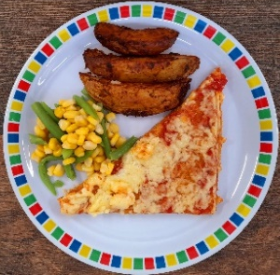


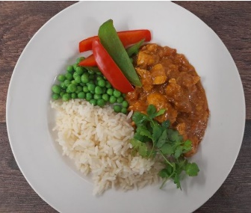
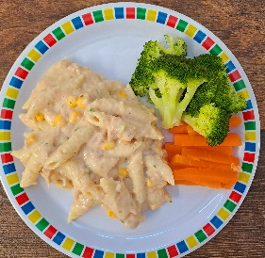

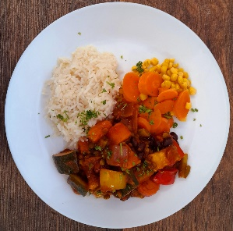
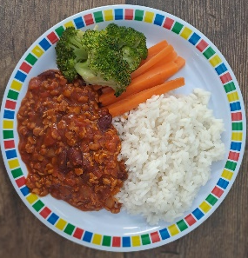
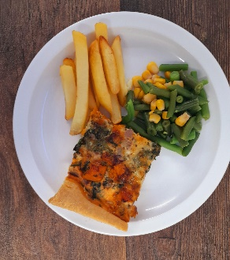

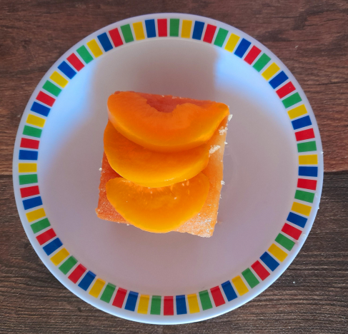

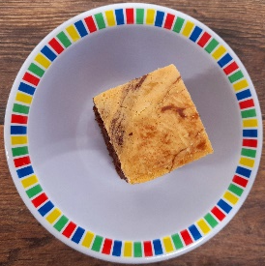
Autumn Winter 2024/2025
Classic Cheese and Tomato Pizza with Wedges
NEW Chicken Pasta Bake with Garlic Bread
Sausage with Mash and Gravy
Chicken Tikka Masala with Rice
NEW Tuna Pasta Bake or Fish Fingers with Chips & Tomato Sauce
Rainbow Vegetable Pizza with Wedges
Chinese Vegetable Curry with Rice
Vegan Sausage with Mash and Gravy
NEW Mild Mexican Chilli with Rice
Cheese and Tomato Quiche with Chips and Tomato Sauce
Marble Sponge Cake with Custard
Jelly with Mandarins
Fruit Medley
Peach Cake
Oaty Cookie

Slide 3


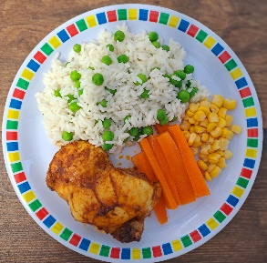

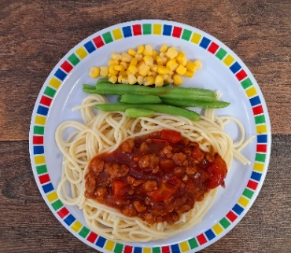

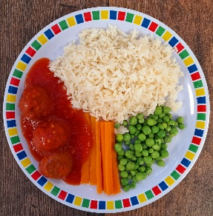
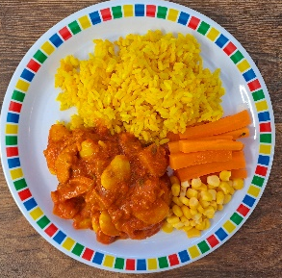





Autumn Winter 2024/2025
Macaroni Cheese
NEW Mild Caribbean Chicken with Rice and Peas
Roast of the Day with Stuffing, Roast Potatoes and Gravy
Spaghetti Bolognaise
Breaded Fish with Chips & Tomato Sauce
Plant Balls in Tomato Sauce with Rice
NEW Caribbean Butterbean Stew with Rice and Peas
Vegan Cottage Pie with Gravy
NEW Hot Pot Baked Bean Casserole with Rice
Cheese & Pepper Omelette with Chips and Tomato Sauce
Chocolate and Beetroot Brownie
Sticky Toffee Apple Crumble with Custard
Fruit Salad
NEW Savoury Cheese Scone
Vanilla Shortbread

